Slide 1
Detecting communities of directed networks via a local algorithm
Authors: Saishree Godbole, Henish Shah, Tanvi Kolhatkar
INDIANA UNIVERSITY

Slide 2
Team Introduction

Slide 3



Introducing our project team
We are all MS in Data Science students at Indiana University Bloomington interested in social media mining and studying the user interactions.
Saishree Godbole
Henish Shah
Tanvi Kolhatkar

Slide 4
Algorithm Keywords Definitions

Slide 5
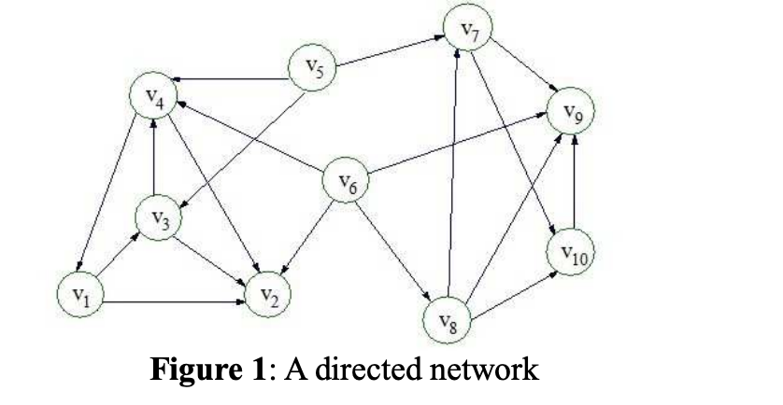
Before we proceed to our algorithm, we wanted to brush up on some of the keywords
Directed Networks
All the edges in this network are directed.
Determining neighbors in a directed network - Considering D(V(D),E(D)) is a directed graph, vertices v_{i}, v_{j} ∈ V(D) ,where v_{i} and v_{j} are neighbors if there is an edge from v_{i} to v_{j}.
For example, we can see there is an edge from v₅ to v₃ , so v₅ is the neighbor of v₃ .

Slide 6
Before we proceed to our algorithm, we wanted to brush up on some of the keywords
Node Strength of a vertex
In a directed graph, the in-degree is the node strength of the vertex.
Determining the node strength - Considering D(V(D),E(D)) is a directed graph, the node strength of vertex v is the number of all the neighbors of v, which is the in-degree of v node as d_{in}(v).
For example, the note strength of vertex v₄ is 3, the node strength of vertex v₆ is 0. If a network is an undirected graph, the node strength of every vertex is equal to their degree.

Slide 7
Before we proceed to our algorithm, we wanted to brush up on some of the keywords
Compactness of a vertex
In a directed graph, the in-degree is the node strength of the vertex.
Determining the node strength - Considering D(V(D),E(D)) is a directed graph, the compactness of vertex v and community c is:
B(v, c) = (d^{c}_{out}(v) + 1)/(d_{out}(v) + 1)
For example, if a community c includes vertices {v₁, v₂, v₃, v₄}, the compactness of vertex v₅ and community c is (2+1)/(3+1) = 0.75

Slide 8
Local Community Detection Algorithm
IMPORTANCE

Slide 9
Need for Local Community Detection Algorithm
The field of community detection has garnered a lot of interest in the recent years with many new algorithms emerging which can be used to detect global community structure. Local communities provide a better measure to understand and visualize the nature of interaction when the global knowledge of networks is unknown.
One application of local community would be in the field of marketing :
Nowadays, social network partitioning has become a very important function. One objective for partitioning is to identify interested communities to target for marketing and advertising activities.
The bottleneck to detection of these communities is the large scalability of the social network. Previous methods did not effectively address the problem because they considered the overall network.
Social networks have strong locality, so designing a local algorithm to find an interested community to address this objective is necessary.

Slide 10
Algorithm Description

Slide 11
Local Community Detection Algorithm by Shigang Liu
As a part of our project, we have tried replicating the findings of the paper ‘Detecting communities of directed networks via a local algorithm’ by Shigang Liu
Based on the principle of the node strength, the division of the local community structure algorithm is proposed in directed and overlapping networks. The main idea of the algorithm is to find an initial community from a node with maximal node strength and to expand the community by adding nodes.
This algorithm caught our eye as it was detecting the simple local communities
The main advantage of the algorithm is that it only requires local information of nodes used, so the time complexity is very low, reaching a linear complexity

Slide 12
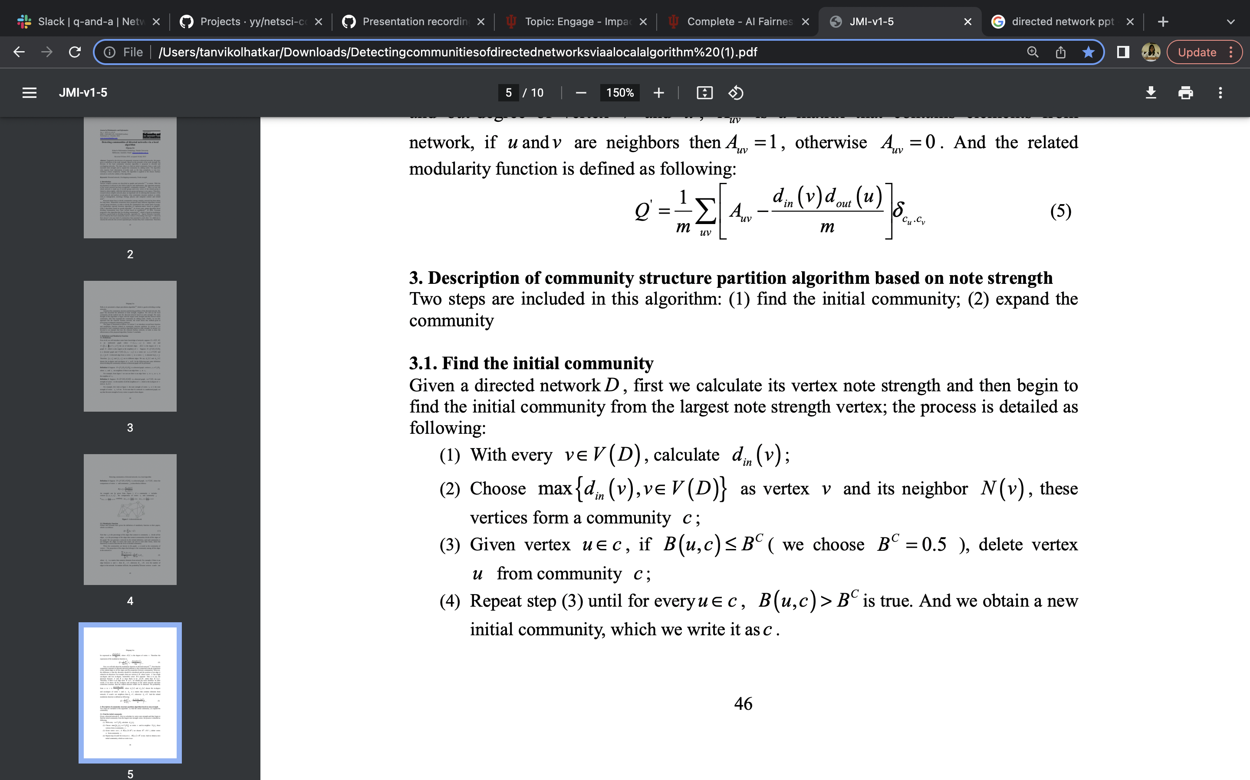
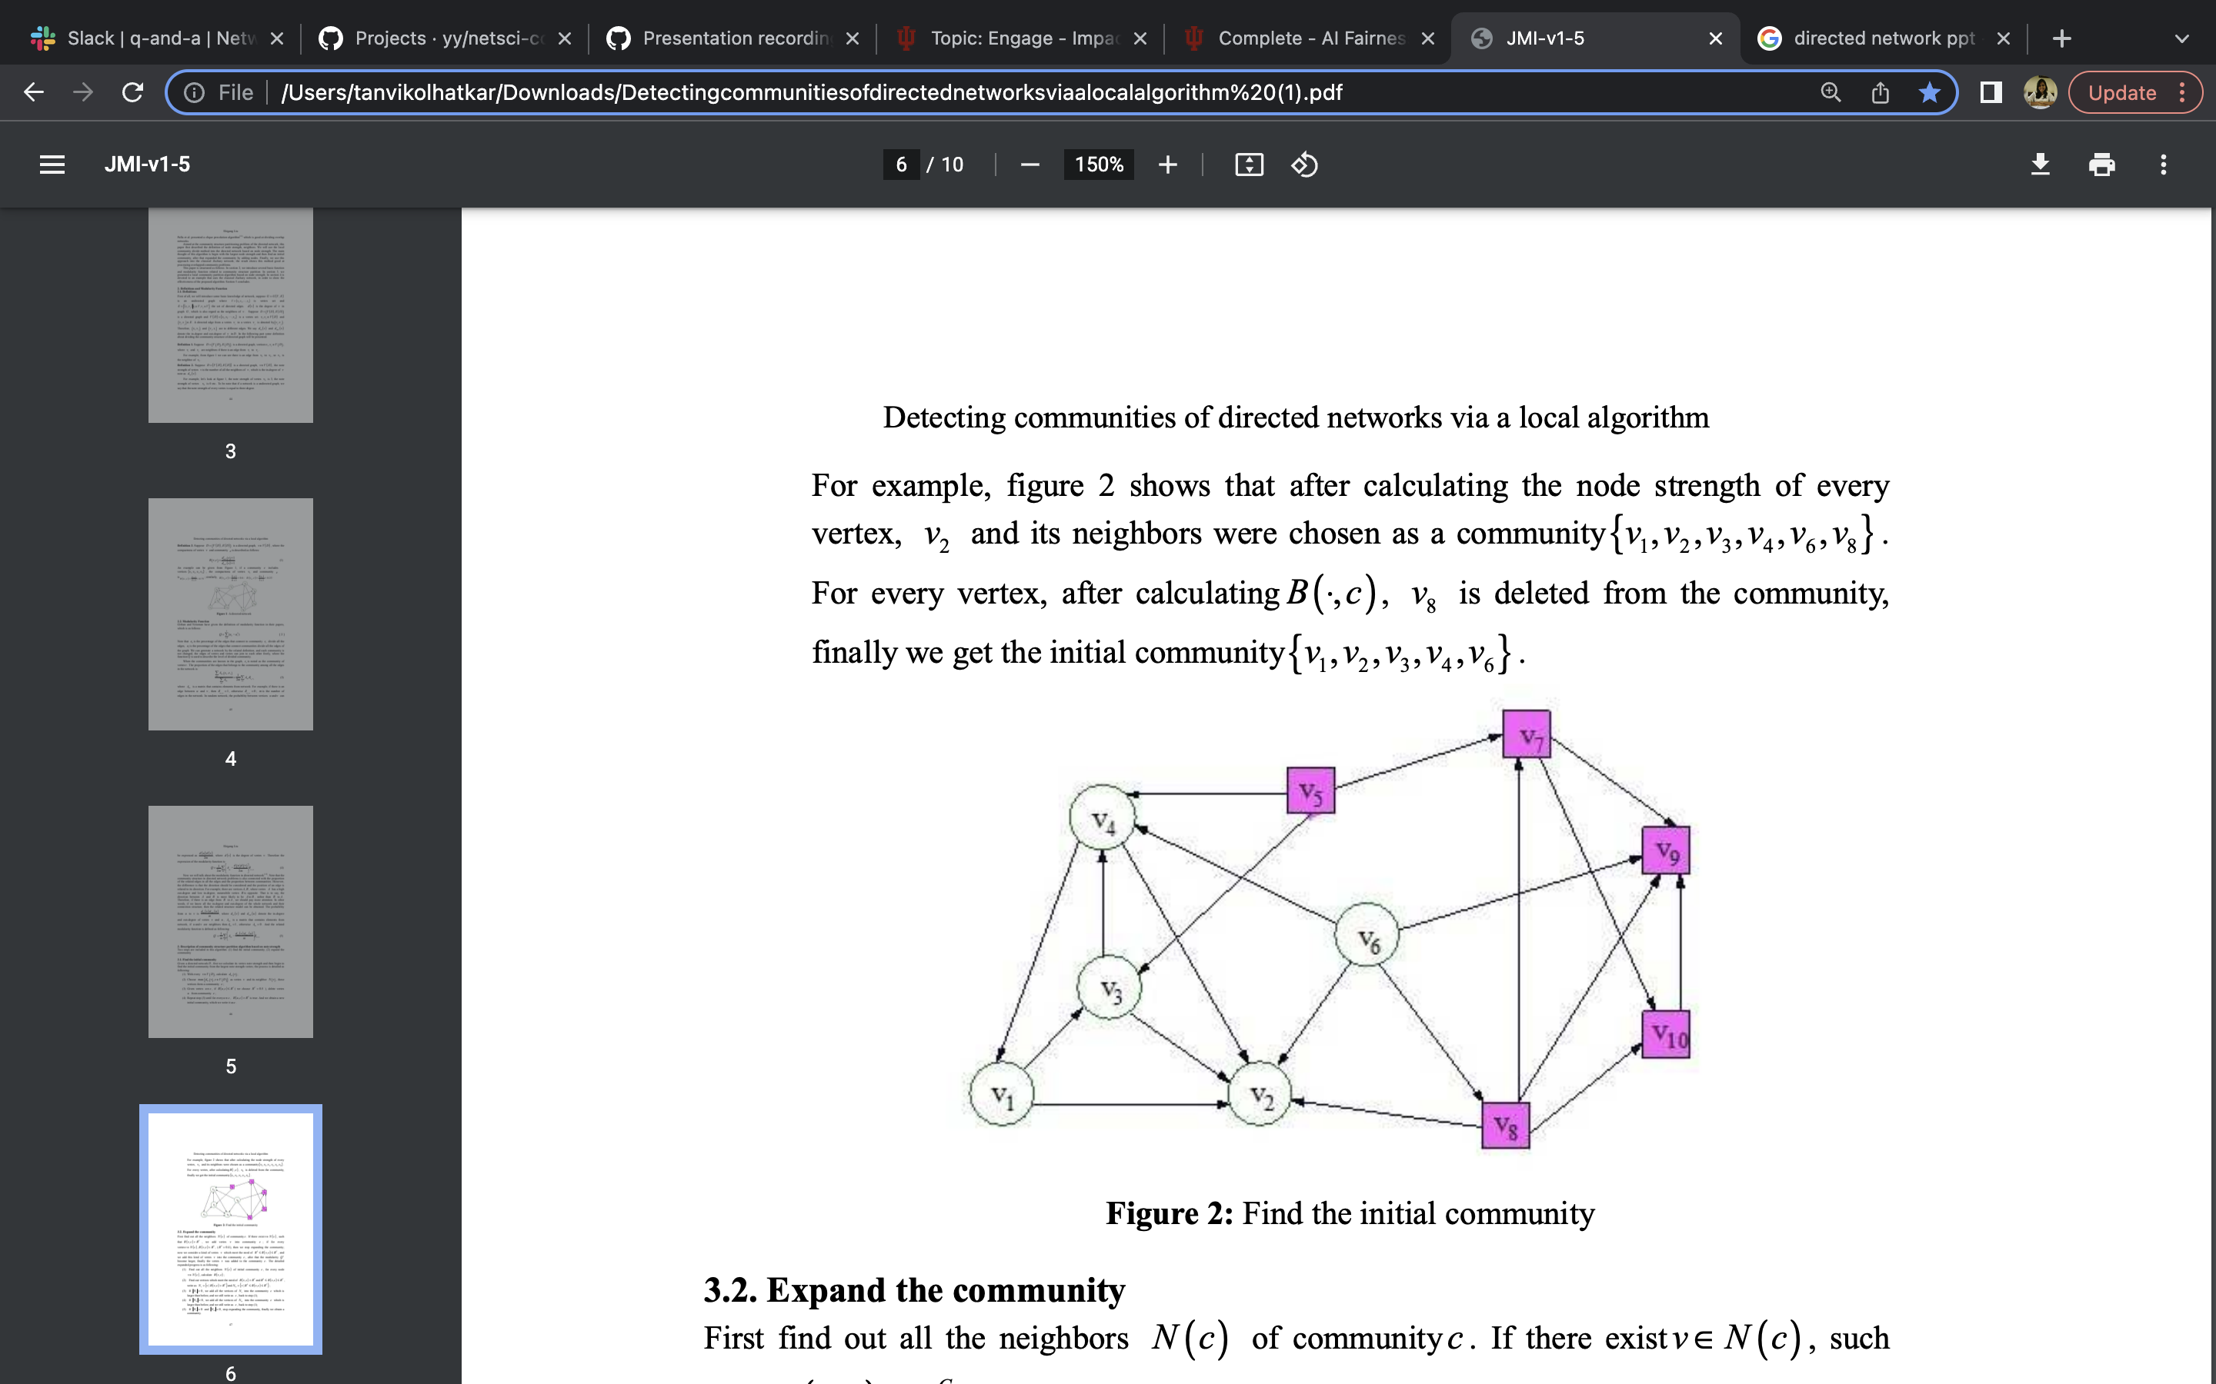
Finding the initial community

Slide 13
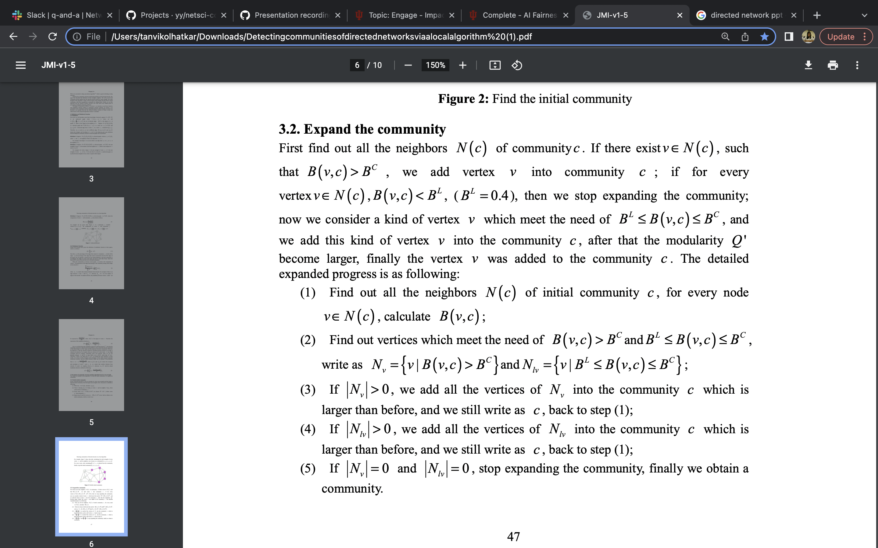
Expanding the initial community

Slide 14
Applications of the Algorithm

Slide 15
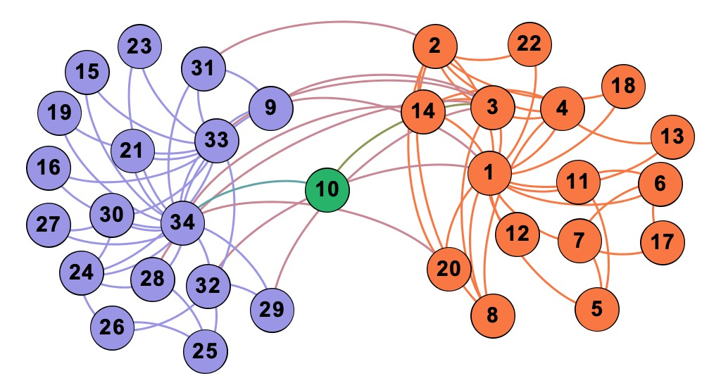
Application of the algorithm on Zachary Karate Club network
We have selected the B^{C} threshold value as 0.5 and the B^{L} threshold value as 0.4 and got two communities (in purple and orange) with node 10 belonging to both communities

Slide 16
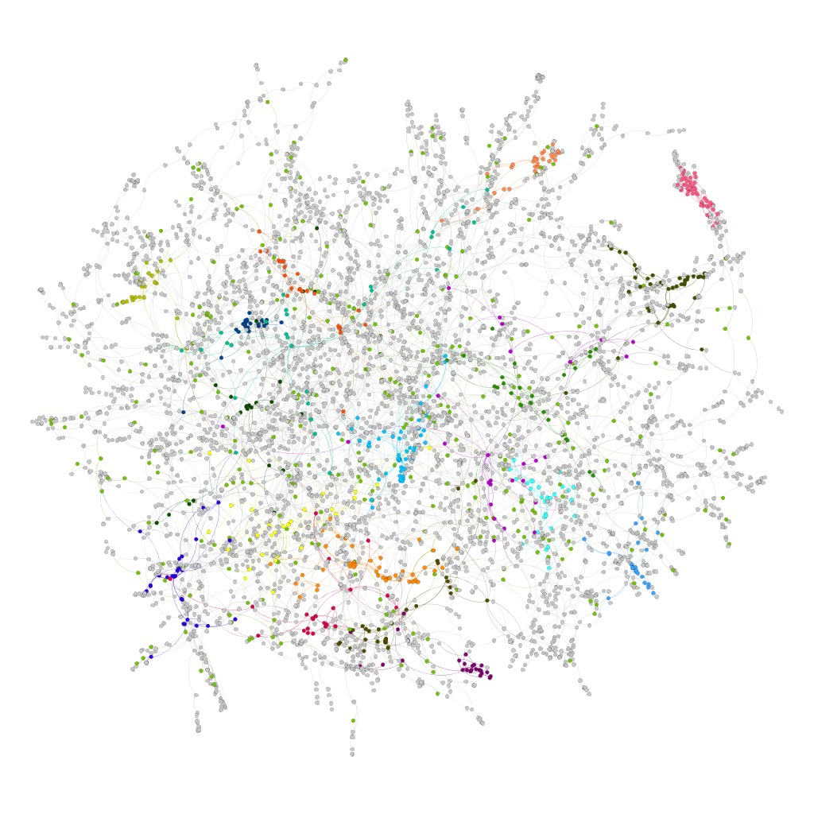
Application of the algorithm on US Power Grid network

Slide 17
Limitations and Further Work

Slide 18
Limitations and Further Work
One of the major issues we faced was that there were no detailed explanations of the algorithm and its applications
Implementation specific to Zachary with lots of assumptions and changes needed to accommodate other networks
In the next few days, we plan to model the parameters of this algorithm on real-world networks.

Slide 19
Thank You! ☺

